Slide 1
CS 2420: Stack
Dr. Tsung-Wei (TW) Huang
Department of Electrical and Computer Engineering
University of Utah, Salt Lake City, UT

Slide 2
Outline
This topic discusses the concept of a stack:
Description of an Abstract Stack
List applications
Implementation
Example applications
Parsing: XHTML, C++
Function calls
Reverse-Polish calculators
Robert’s Rules
Standard Template Library

Slide 3
Abstract Stack
An Abstract Stack (Stack ADT) is an abstract data type which emphasizes specific operations:
Uses a explicit linear ordering
Insertions and removals are performed individually
Inserted objects are pushed onto the stack
The top of the stack is the most recently object pushed onto the stack
When an object is popped from the stack, the current top is erased

Slide 4
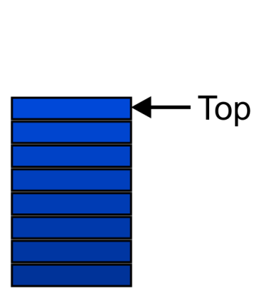
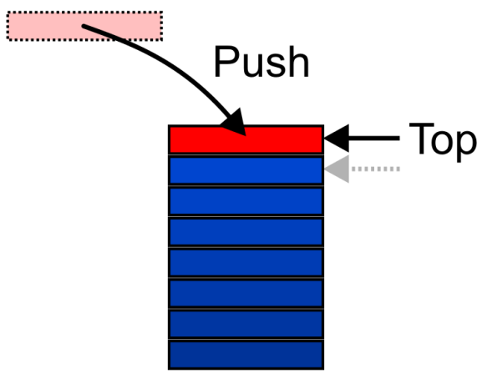
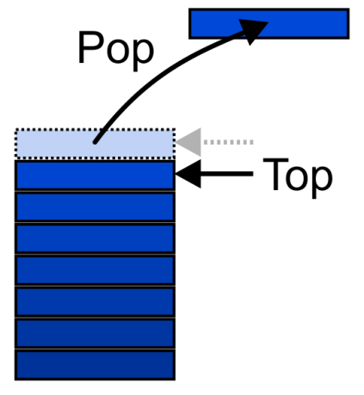
Stack Definition
Also called a last-in–first-out (LIFO) behaviour
Graphically, we may view these operations as follows:
There are two exceptions associated with abstract stacks:
It is an undefined operation to call either pop or top on an empty stack

Slide 5
Stack Applications
Numerous applications:
Parsing code:
Matching parenthesis
XML (e.g., XHTML)
Tracking function calls
Dealing with undo/redo operations
Reverse-Polish calculators
Assembly language
The stack is a very simple data structure
Given any problem, if it is possible to use a stack, this significantly simplifies the solution

Slide 6
Stack Applications
Problem solving:
Solving one problem may lead to subsequent problems
These problems may result in further problems
As problems are solved, your focus shifts back to the problem which lead to the solved problem
Notice that function calls behave similarly:
A function is a collection of code which solves a problem

Slide 7
Stack Implementation
We will look at two implementations of stacks:
Singly linked lists
One-ended arrays
The optimal asymptotic run time of any algorithm is Θ(1)
The run time of the algorithm is independent of the number of objects being stored in the container
We will always attempt to achieve this lower bound

Slide 8
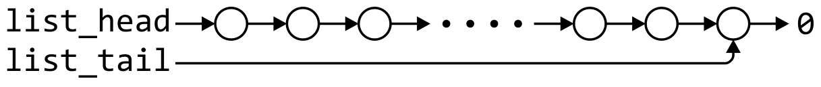
Linked-List Implementation
Operations at the front of a singly linked list are all Θ(1)
The desired behaviors of an Abstract Stack may be reproduced by performing all operations at the front
 | Front/1st | Back/n^{th}
Find | Θ(1) | Θ(1)
Insert | Θ(1) | Θ(1)
Erase | Θ(1) | Θ(n)

Slide 9
Single_list Definition
template <typename Type>
class Single_list {
public:
Single_list();
~Single_list();
int size() const;
bool empty() const;
Type front() const;
Type back() const;
Single_node<Type> *head() const;
Single_node<Type> *tail() const;
int count( Type const & ) const;
void push_front( Type const & );
void push_back( Type const & );
Type pop_front();
int erase( Type const & );
};

Slide 10
Stack-as-List Class
The stack class using a singly linked list has a single private member variable:
template <typename Type>
class Stack {
private:
Single_list<Type> list;
public:
bool empty() const;
Type top() const;
void push( Type const & );
Type pop();
};

Slide 11
Stack-as-List Class
template <typename Type>
class Stack {
private:
Single_list<Type> list;
public:
bool empty() const;
Type top() const;
void push( Type const & );
Type pop();
};
A constructor and destructor is not needed
Because list is declared, the compiler will call the constructor of the Single_list class when the Stack is constructed
Notes:
11

Slide 12
Stack-as-List Class
The empty and push functions just call the appropriate functions of the Single_list class
template <typename Type>
bool Stack<Type>::empty() const {
return list.empty();
}
template <typename Type>
void Stack<Type>::push( Type const &obj ) {
list.push_front( obj );
}
Notes:
12

Slide 13
Stack-as-List Class
The top and pop functions, however, must check the boundary case:
template <typename Type>
Type Stack<Type>::top() const {
if ( empty() ) {
throw underflow();
}
return list.front();
}
template <typename Type>
Type Stack<Type>::pop() {
if ( empty() ) {
throw underflow();
}
return list.pop_front();
}

Slide 14
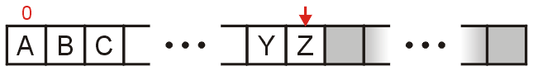
Array Implementation
For one-ended arrays, all operations at the back are Θ(1)
 | Front/1st | Back/n^{th}
Find | Θ(1) | Θ(1)
Insert | Θ(n) | Θ(1)
Erase | Θ(n) | Θ(1)

Slide 15
Destructor
We need to store an array:
In C++, this is done by storing the address of the first entry
Type *array;
We need additional information, including:
The number of objects currently in the stack
int stack_size;
The capacity of the array
int array_capacity;
Notes:
15

Slide 16
Stack-as-Array Class
We need to store an array (address of the first entry)
template <typename Type>
class Stack {
private:
int stack_size;
int array_capacity;
Type *array;
public:
Stack( int = 10 );
~Stack();
bool empty() const;
Type top() const;
void push( Type const & );
Type pop();
};

Slide 17
Constructor
The class is only storing the address of the array
We must allocate memory for the array and initialize the member variables
The call to new Type[array_capacity] makes a request to the operating system for array_capacity objects
#include <algorithm>
// ...
template <typename Type>
Stack<Type>::Stack( int n ):
stack_size( 0 ),
array_capacity( std::max( 1, n ) ),
array( new Type[array_capacity] ) {
// Empty constructor
}

Slide 18
Constructor
template <typename Type>
class Stack {
private:
int stack_size;
int array_capacity;
Type *array;
public:
Stack( int = 10 );
~Stack();
bool empty() const;
Type top() const;
void push( Type const & );
Type pop();
};
template <typename Type>
Stack<Type>::Stack( int n ):
stack_size( 0 ),
array_capacity( std::max( 1, n ) ),
array( new Type[array_capacity] ) {
// Empty constructor
}
Warning: in C++, the variables are initialized in the order in which they are defined:
Notes:
18

Slide 19
Destructor
The call to new in the constructor requested memory from the operating system
The destructor must return that memory to the operating system:
template <typename Type>
Stack<Type>::~Stack() {
delete [] array;
}

Slide 20
Empty
The stack is empty if the stack size is zero:
template <typename Type>
bool Stack<Type>::empty() const {
return ( stack_size == 0 );
}
The following is unnecessarily tedious:
The == operator evaluates to either true or false
if ( stack_size == 0 ) {
return true;
} else {
return false;
}

Slide 21
Top
If there are n objects in the stack, the last is at index n – 1
template <typename Type>
Type Stack<Type>::top() const {
if ( empty() ) {
throw underflow();
}
return array[stack_size - 1];
}
Notes:
21

Slide 22
Pop
Removing an object simply involves reducing the size
It is invalid to assign the last entry to “0”
By decreasing the size, the previous top of the stack is now at the location stack_size
template <typename Type>
Type Stack<Type>::pop() {
if ( empty() ) {
throw underflow();
}
--stack_size;
return array[stack_size];
}
Notes:
22

Slide 23
Push
Pushing an object onto the stack can only be performed if the array is not full
template <typename Type>
void Stack<Type>::push( Type const &obj ) {
if ( stack_size == array_capacity ) {
throw overflow(); // Best solution?????
}
array[stack_size] = obj;
++stack_size;
}

Slide 24
Exceptions
The case where the array is full is not an exception defined in the Abstract Stack
If the array is filled, we have five options:
Increase the size of the array
Throw an exception
Ignore the element being pushed
Replace the current top of the stack
Put the pushing process to “sleep” until something else removes the top of the stack
Include a member function bool full() const;

Slide 25
Array Capacity
If dynamic memory is available, the best option is to increase the array capacity
If we increase the array capacity, the question is:
How much?
By a constant? array_capacity += c;
By a multiple? array_capacity *= c;

Slide 26
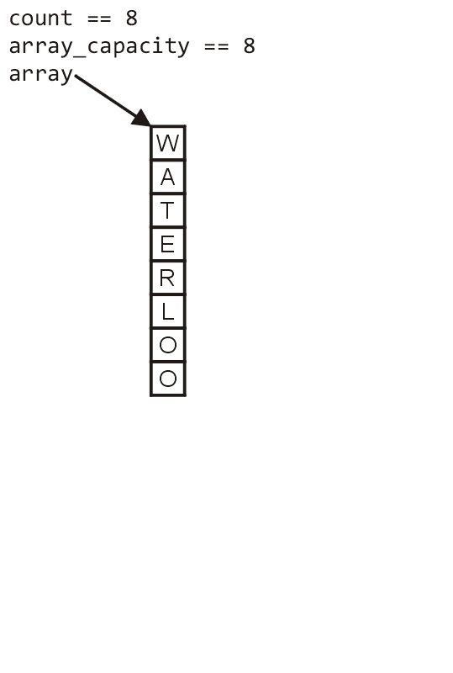
Array Capacity
First, let us visualize what must occur to allocate new memory

Slide 27
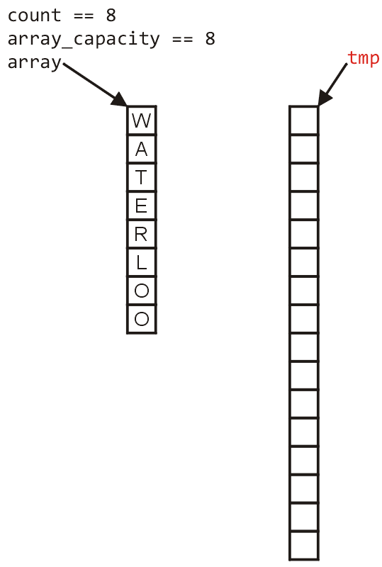
Array Capacity
First, this requires a call to new Type[N] where N is the new capacity
We must have access to this so we must store the address returned by new in a local variable, say tmp

Slide 28
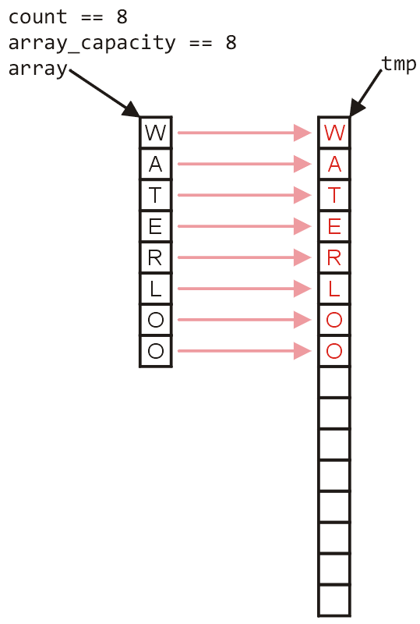
Array Capacity
Next, the values must be copied over

Slide 29
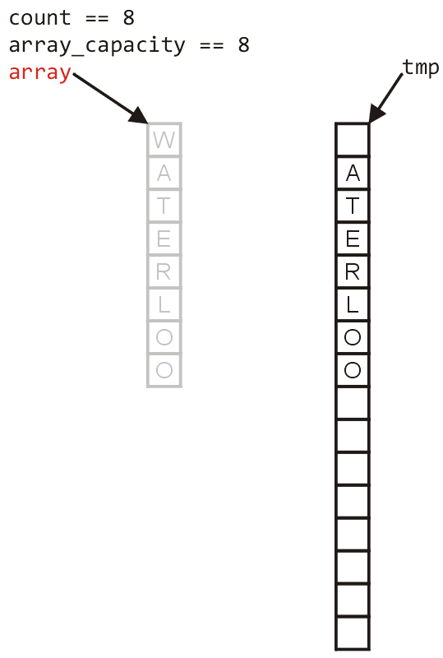
Array Capacity
W
The memory for the original array must be deallocated

Slide 30
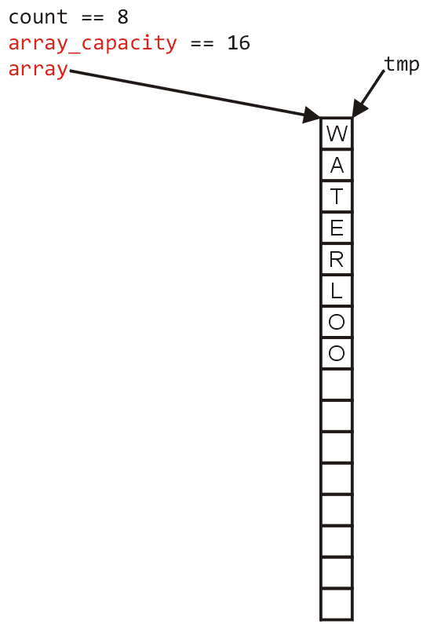
Array Capacity
Finally, the appropriate member variables must be reassigned

Slide 31
Array Capacity
The implementation:
void double_capacity() {
Type *tmp_array = new Type[2*array_capacity];
}

Slide 32
Array Capacity
tmp_array
The implementation:
void double_capacity() {
Type *tmp_array = new Type[2*array_capacity];
for ( int i = 0; i < array_capacity; ++i ) {
tmp_array[i] = array[i];
}
}

Slide 33
Array Capacity
tmp_array
W
The implementation:
void double_capacity() {
Type *tmp_array = new Type[2*array_capacity];
for ( int i = 0; i < array_capacity; ++i ) {
tmp_array[i] = array[i];
}
delete [] array;
}

Slide 34
Array Capacity
tmp_array
The implementation:
void double_capacity() {
Type *tmp_array = new Type[2*array_capacity];
for ( int i = 0; i < array_capacity; ++i ) {
tmp_array[i] = array[i];
}
delete [] array;
array = tmp_array;
array_capacity *= 2;
}

Slide 35
Array Capacity
Back to the original question:
How much do we change the capacity?
Add a constant?
Multiply by a constant?
First, we recognize that any time that we push onto a full stack, this requires n copies and the run time is Θ(n)
Therefore, push is usually Θ(1) except when new memory is required

Slide 36
Array Capacity
To state the average run time, we will introduce the concept of amortized time:
If n operations requires Θ(f(n)), we will say that an individual operation has an amortized run time of Θ(f(n)/n)
Therefore, if inserting n objects requires:
Θ(n²) copies, the amortized time is Θ(n)
Θ(n) copies, the amortized time is Θ(1)

Slide 37
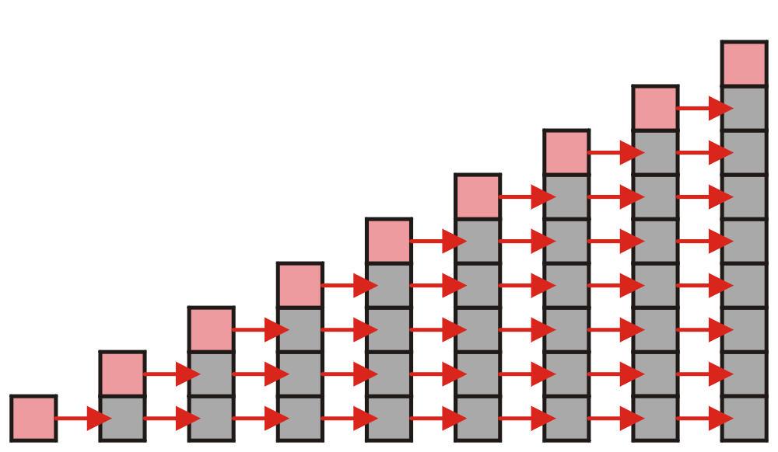
Array Capacity
Let us consider the case of increasing the capacity by 1 each time the array is full
With each insertion when the array is full, this requires all entries to be copied

Slide 38
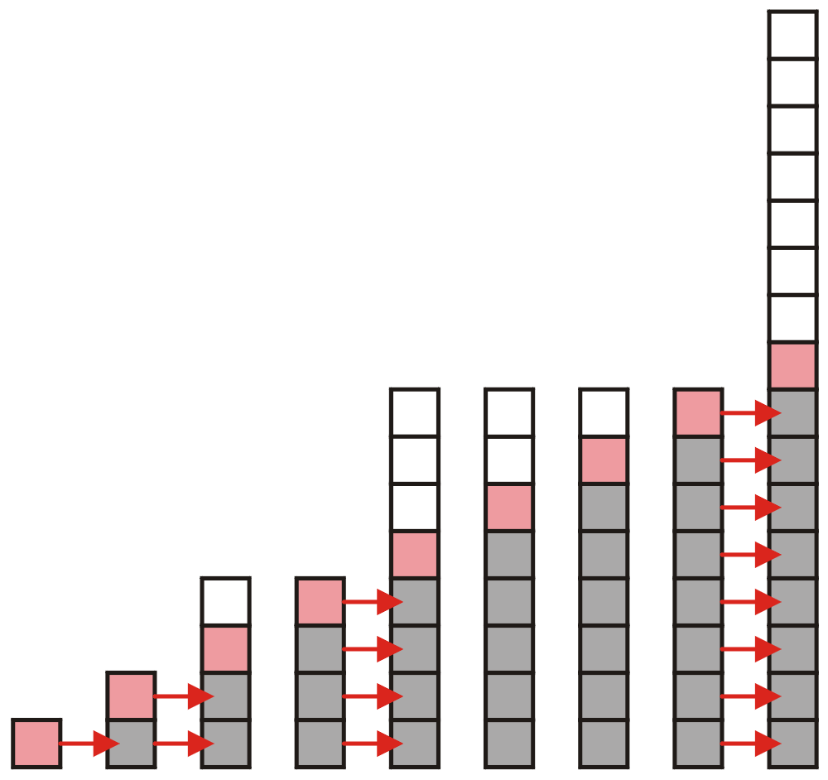
Array Capacity
Suppose we double the number of entries each time the array is full
Now the number of copies appears to be significantly fewer

Slide 39
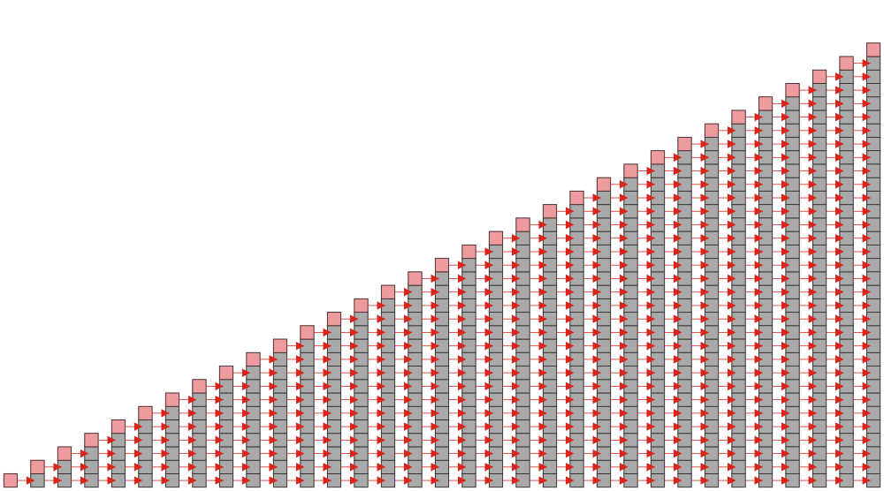
Array Capacity
Suppose we insert n objects
The pushing of the k^{th} object on the stack requires k – 1 copies
The total number of copies is now given by:
Therefore, the amortized number of copies is given by
Therefore each push must run in Θ(n) time
The wasted space, however is Θ(1)

Slide 40
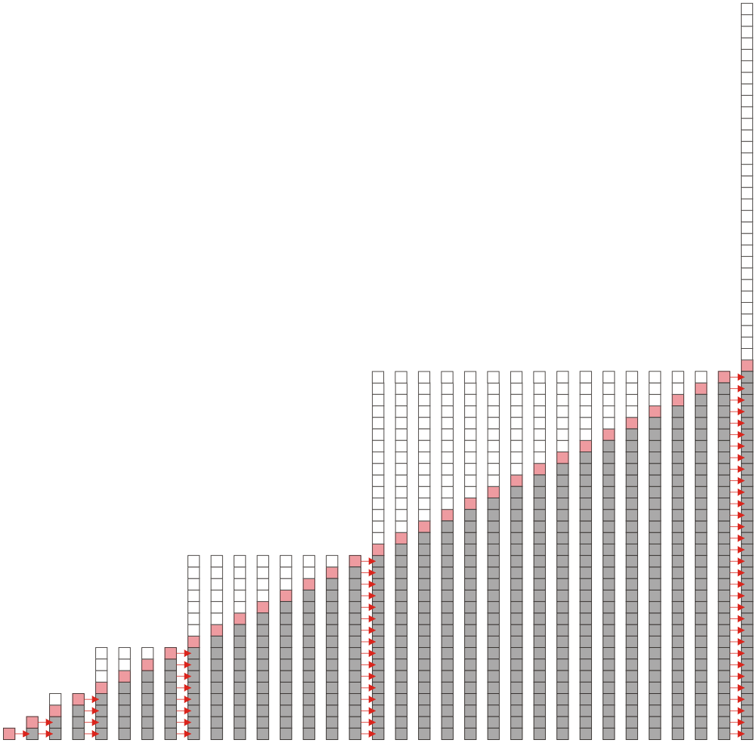
Array Capacity
Suppose we double the array size each time it is full:
This is difficult to solve for an arbitrary n so instead, we will restrict the number of objects we are inserting to n = 2^{h} objects
We will then assume that the behavior for intermediate values of n will be similar

Slide 41
Array Capacity
Suppose we double the array size each time it is full:
Inserting n = 2^{h} objects would therefore require
1, 2, 4, 8, …, 2^{h–1}
copies, for once we add the last object, the array will be full
The total number of copies is therefore:
Therefore the amortized number of copies per insertion is Θ(1)
The wasted space, however is O(n)

Slide 42
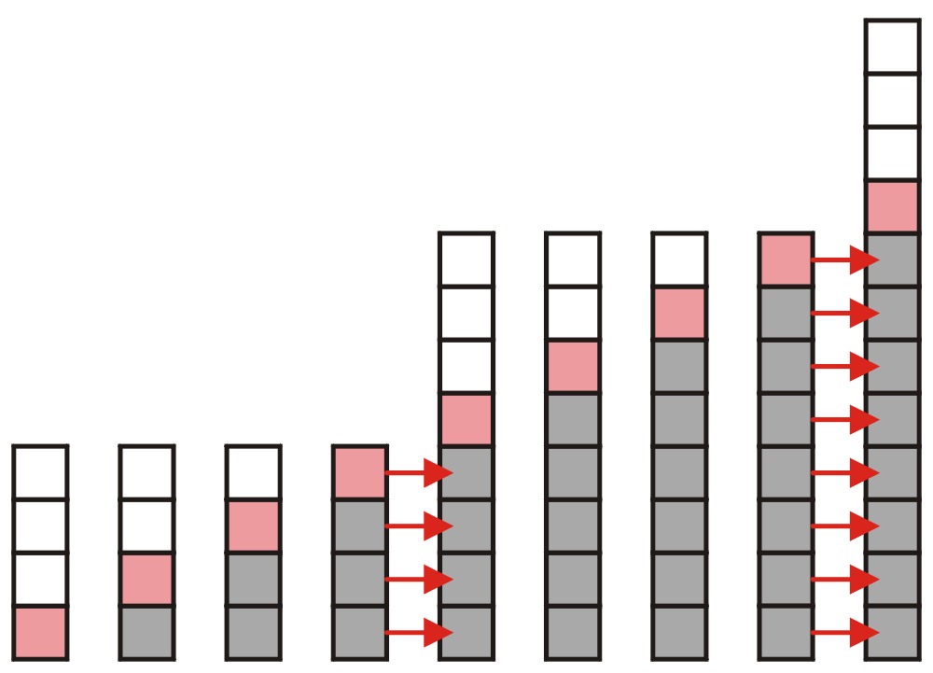
Array Capacity
What if we increase the array size by a larger constant?
For example, increase the array size by 4, 8, 100?

Slide 43
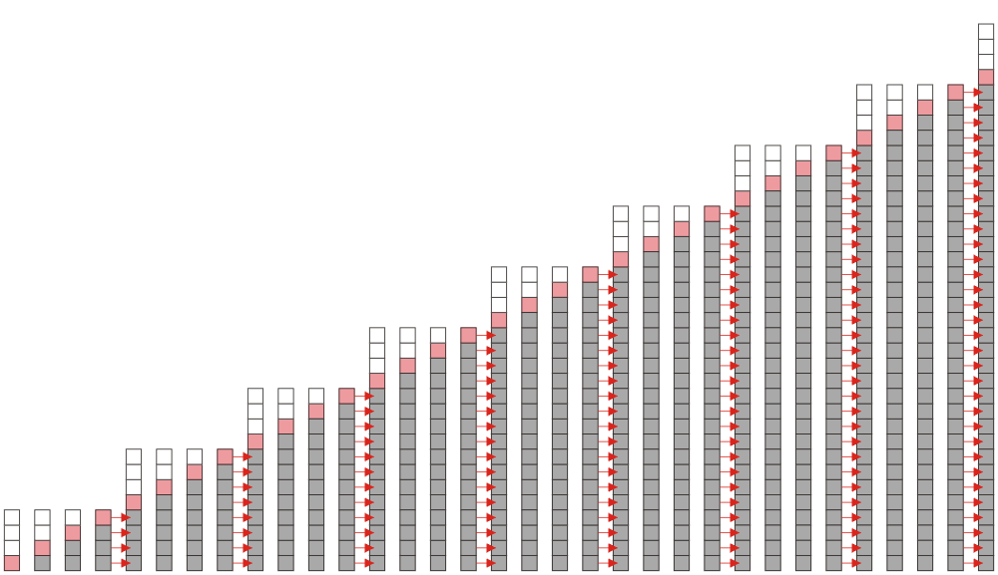
Array Capacity
Suppose we increase it by a constant m and we add n = ℓm objects
To add n items, we will have to make
m, 2m, 3m, …, (ℓ – 1)m
copies in total, or
The amoritized number of copies is
as m is fixed

Slide 44
Array Capacity
 | Copies per Insertion | Unused Memory
Increase by 1 | n – 1 | 0
Increase by m | n/m | m – 1
Increase by a factor of 2 | 1 | n
Increase by a factor of r > 1 | 1/(r – 1) | (r – 1)n
Note the difference in worst-case amortized scenarios:

Slide 45
LAB: std::stack
C++ Standard Template Library (STL) stack
https://en.cppreference.com/w/cpp/container/stack
/* stack example */
#include <iostream>
#include <stack>
int main()
{
std::stack<int> stk;
stk.push(1);
stk.push(2);
std::cout<<stk.top();
/* clear the stack */
while(!stk.empty())
stk.pop();
}
Notes:
Good news is the standard template library (STL) has provided us a stack implementation. It's a template library for you to create a stack to hold arbitrary types of items. The usage is as follows: (include -> template -> push -> query -> drain out all items)
You may find more useful information at the official stack reference. That page has a very clear explanation about each method defined in the stack and the meaning of each API.

Slide 46
Reverse-Polish Notation
Normally, mathematics is written using what we call in-fix notation:
(3 + 4) × 5 – 6
The operator is placed between to operands
One weakness: parentheses are required
(3 + 4) × 5 – 6 = 29
3 + 4 × 5 – 6 = 17
3 + 4 × (5 – 6) = –1
(3 + 4) × (5 – 6) = –7

Slide 47
Reverse-Polish Notation
Alternatively, we can place the operands first, followed by the operator:
(3 + 4) × 5 – 6
3 4 + 5 × 6 –
Parsing reads left-to-right and performs any operation on the last two operands:
3 4 + 5 × 6 –
7 5 × 6 –
35 6 –
29

Slide 48
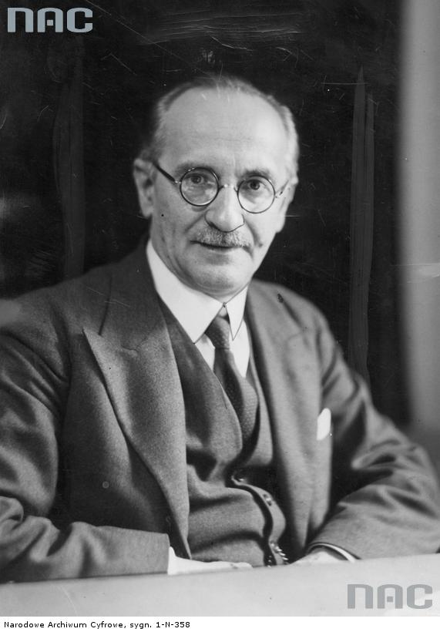
Reverse-Polish Notation
This is called reverse-Polish notation after the mathematician Jan Łukasiewicz
This forms the basis of the recursive stack used on all processors
He also made significant contributions to logic and other fields
Electrical engineering
Computer-aided design
VLSI
http://www.audiovis.nac.gov.pl/

Slide 49
Reverse-Polish Notation
Other examples:
3 4 5 × + 6 –
3 20 + 6 –
23 6 –
17
3 4 5 6 – × +
3 4 –1 × +
3 –4 +
–1

Slide 50
Reverse-Polish Notation
Benefits:
No ambiguity and no brackets are required
It is the same process used by a computer to perform computations:
operands must be loaded into registers before operations can be performed on them
Reverse-Polish can be processed using stacks

Slide 51

Reverse-Polish Notation
Reverse-Polish notation is used with some programming languages
e.g., postscript, pdf, and HP calculators
Similar to the thought process required for writing assembly language code
you cannot perform an operation until you have all of the operands loaded into registers
MOVE.L #$2A, D1 ; Load 42 into Register D1
MOVE.L #$100, D2 ; Load 256 into Register D2
ADD D2, D1 ; Add D2 into D1

Slide 52
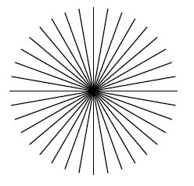
Reverse-Polish Notation
A quick example of postscript:
0 10 360 { % Go from 0 to 360 degrees in 10-degree steps
newpath % Start a new path
gsave % Keep rotations temporary
144 144 moveto
rotate % Rotate by degrees on stack from 'for'
72 0 rlineto
stroke
grestore % Get back the unrotated state
} for % Iterate over angles
http://www.tailrecursive.org/postscript/examples/rotate.html

Slide 53
Reverse-Polish Notation
The easiest way to parse reverse-Polish notation is to use an operand stack:
operands are processed by pushing them onto the stack
when processing an operator:
pop the last two items off the operand stack,
perform the operation, and
push the result back onto the stack

Slide 54
Reverse-Polish Notation
Evaluate the following reverse-Polish expression using a stack:
1 2 3 + 4 5 6 × – 7 × + – 8 9 × +

Slide 55
Reverse-Polish Notation
Push 1 onto the stack
1 2 3 + 4 5 6 × – 7 × + – 8 9 × +
1

Slide 56
Reverse-Polish Notation
Push 1 onto the stack
1 2 3 + 4 5 6 × – 7 × + – 8 9 × +
2
1

Slide 57
Reverse-Polish Notation
Push 3 onto the stack
1 2 3 + 4 5 6 × – 7 × + – 8 9 × +
3
2
1

Slide 58
Reverse-Polish Notation
Pop 3 and 2 and push 2 + 3 = 5
1 2 3 + 4 5 6 × – 7 × + – 8 9 × +
5
1

Slide 59
Reverse-Polish Notation
Push 4 onto the stack
1 2 3 + 4 5 6 × – 7 × + – 8 9 × +
4
5
1

Slide 60
Reverse-Polish Notation
Push 5 onto the stack
1 2 3 + 4 5 6 × – 7 × + – 8 9 × +
5
4
5
1

Slide 61
Reverse-Polish Notation
Push 6 onto the stack
1 2 3 + 4 5 6 × – 7 × + – 8 9 × +
6
5
4
5
1

Slide 62
Reverse-Polish Notation
Pop 6 and 5 and push 5 × 6 = 30
1 2 3 + 4 5 6 × – 7 × + – 8 9 × +
30
4
5
1

Slide 63
Reverse-Polish Notation
Pop 30 and 4 and push 4 – 30 = –26
1 2 3 + 4 5 6 × – 7 × + – 8 9 × +
–26
5
1

Slide 64
Reverse-Polish Notation
Push 7 onto the stack
1 2 3 + 4 5 6 × – 7 × + – 8 9 × +
7
–26
5
1

Slide 65
Reverse-Polish Notation
Pop 7 and –26 and push –26 × 7 = –182
1 2 3 + 4 5 6 × – 7 × + – 8 9 × +
–182
5
1

Slide 66
Reverse-Polish Notation
Pop –182 and 5 and push –182 + 5 = –177
1 2 3 + 4 5 6 × – 7 × + – 8 9 × +
–177
1

Slide 67
Reverse-Polish Notation
Pop –177 and 1 and push 1 – (–177) = 178
1 2 3 + 4 5 6 × – 7 × + – 8 9 × +
178

Slide 68
Reverse-Polish Notation
Push 8 onto the stack
1 2 3 + 4 5 6 × – 7 × + – 8 9 × +
8
178

Slide 69
Reverse-Polish Notation
Push 1 onto the stack
1 2 3 + 4 5 6 × – 7 × + – 8 9 × +
9
8
178

Slide 70
Reverse-Polish Notation
Pop 9 and 8 and push 8 × 9 = 72
1 2 3 + 4 5 6 × – 7 × + – 8 9 × +
72
178

Slide 71
Reverse-Polish Notation
Pop 72 and 178 and push 178 + 72 = 250
1 2 3 + 4 5 6 × – 7 × + – 8 9 × +
250

Slide 72
Reverse-Polish Notation
Thus
1 2 3 + 4 5 6 × – 7 × + – 8 9 × +
evaluates to the value on the top: 250
The equivalent in-fix notation is
((1 – ((2 + 3) + ((4 – (5 × 6)) × 7))) + (8 × 9))
We reduce the parentheses using order-of-operations:
1 – (2 + 3 + (4 – 5 × 6) × 7) + 8 × 9

Slide 73
Reverse-Polish Notation
Incidentally,
1 – 2 + 3 + 4 – 5 × 6 × 7 + 8 × 9 = – 132
which has the reverse-Polish notation of
1 2 – 3 + 4 + 5 6 7 × × – 8 9 × +
For comparison, the calculated expression was
1 2 3 + 4 5 6 × – 7 × + – 8 9 × +

Slide 74
Standard Template Library
The Standard Template Library (STL) has a wrapper class stack with the following declaration:
template <typename T>
class stack {
public:
stack(); // not quite true...
bool empty() const;
int size() const;
const T & top() const;
void push( const T & );
void pop();
};

Slide 75
Standard Template Library
#include <iostream>
#include <stack>
using namespace std;
int main() {
stack<int> istack;
istack.push( 13 );
istack.push( 42 );
cout << "Top: " << istack.top() << endl;
istack.pop(); // no return value
cout << "Top: " << istack.top() << endl;
cout << "Size: " << istack.size() << endl;
return 0;
}

Slide 76
Standard Template Library
The reason that the stack class is termed a wrapper is because it uses a different container class to actually store the elements
The stack class simply presents the stack interface with appropriately named member functions:
push, pop , and top

Slide 77
Summary
The stack is the simplest of all ADTs
Understanding how a stack works is trivial
The application of a stack, however, is not in the implementation, but rather:
Where possible, create a design which allows the use of a stack
We looked at:
Parsing, function calls, and reverse Polish

